Slide 1
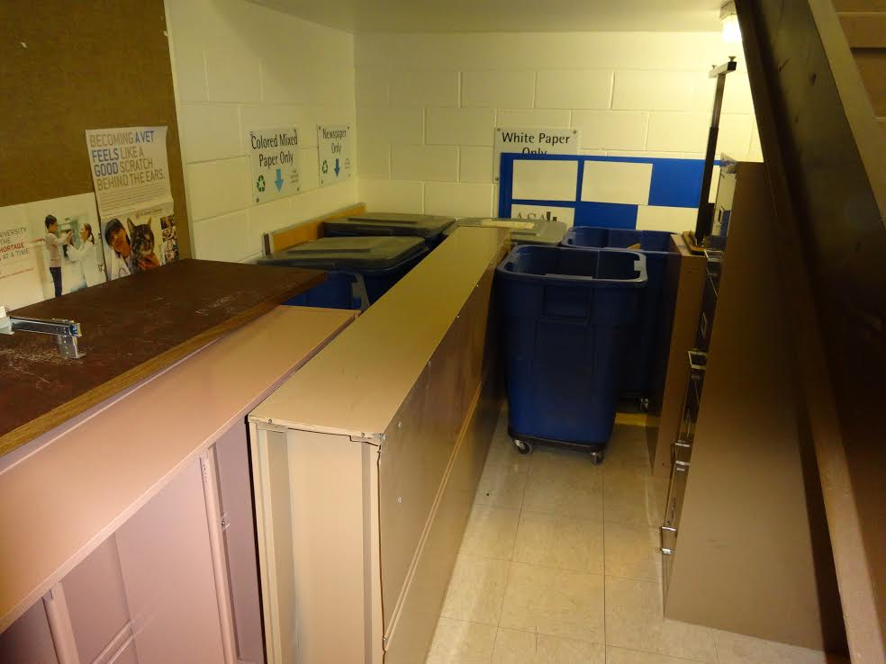
Energy Makes the World Go Around
David M. Boje

Slide 2
Hidden Costs Ch. 9 The Strategic Piloting Indicator Logbook
DOWNLOAD TEMPLATE of 'PILOTING LOGBOOK' IN WORD FOR YOUR TEAM's Mid-TERM PAPER
Here is BOJE’s PILOTING LOGBOOK MIDTERM REPORT http://davidboje.com/448/report%20template%202018%20BOJE.docx
Have steps 1-13 completed, and 5 hours of time with client
Which UN Sustainable Development Goal are you helping your client to achieve?
For mid-term each team create a skit to show the main hidden costs of the main dysfunction you have uncovered with your client.

Slide 3
Midterm
Each team does a Boalian Forum Theater skit, or an Hellinger Family Business Intergenerational Theater
Please Each Team, declare in your Presentation, which of the 17 UN Sustainable Development goals, you are working with your client to make a reality through your consulting
BRING COPY OF YOUR TEAMS's PROJECT LOGBOOK, single space, double sided printing, & copy of FILLED OUT mid-term check list, & your individual LOGBOOK SHEET OF GRADES RECEIVED/PARTICIPATION/MAKE UPS TODATE. Thank yu (each team bring food, to make this fun event for themselves; have peer review in sealed envelope)

Slide 4
Recycling in Business Complex Building moved from lobby and third floor locations to beneath the first floor stairwell
THINGS TELL A STORY
Observe the Micro-Spaces of THINGS telling a story

Slide 5
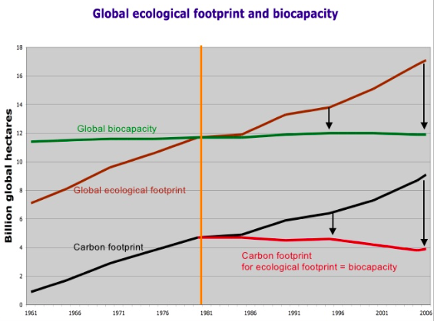
https://es.slideshare.net/degrowthbcn/climate-change-and-the-economic-crisis-is-prosperity-possible-without-growth

Slide 6
Feminist Leadership & Small Business DeGrowth names an alternative Future
A feminist economy seeks to restore the legitimate rights of communities to these common resources. This autonomy is enabling them to sustain themselves; while evolving more egalitarian systems of governance and use of such resources. A feminist economy acknowledges women’s roles and provides equal opportunities for decision-making, i.e. women as equal claimants to these resources. https://www.awid.org/reclaiming-commons
See Environmental Justice https://www.slideshare.net/environmentalconflicts/02-07martinezalierej-and-degrowth

Slide 7
Energy Returned/Energy Invested (EROEI) Energy Return on Investment (EROI)
It takes energy to generate Energy-ROI (EROI).
AKA➔Energy Returned on Energy Invested (EROEI)
e.g. Energy to find it, pump it, transport it, process it, transport it again, and energy to make all the materials (steel, aluminum, etc.) to make the transport vehicles, energy to feed & clothe the workers, energy to make their clothes, etc.
Energy Return off Investment (EROI) less than 1 means more energy expended getting the energy resource than it can deliver payback.

Slide 8
Energy Returned/Energy Invested (EROEI) Energy Return on Investment (EROI)
Energy makes the world go around
Energy is needed to have economies
Energy is need to have cultures
Energy is needed for production, consumption, & distribution of goods and services
Energy surplus creates stability
Energy surplus necessary for health & education
Energy is fundamental to Leadership & Small Business
EROEI & EROI depend upon hidden costs calculations

Slide 9
Charles Hall

Slide 11
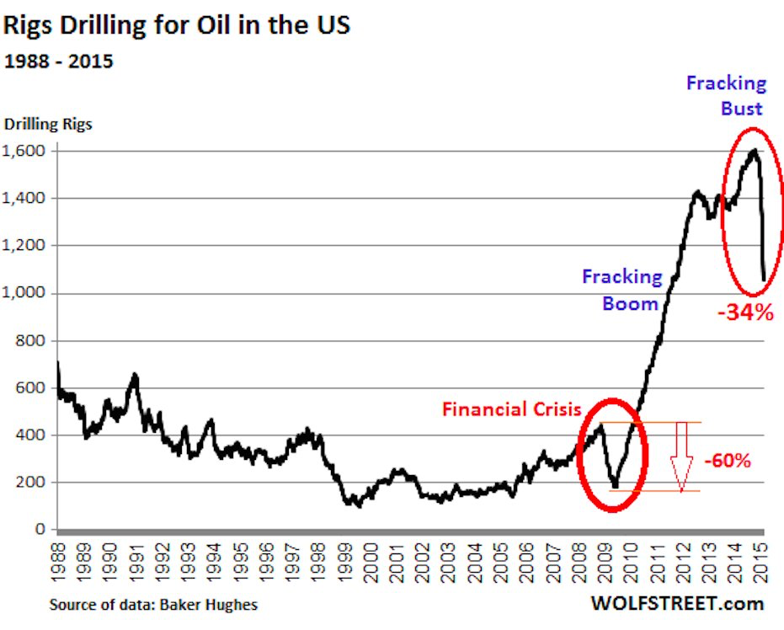

Slide 12
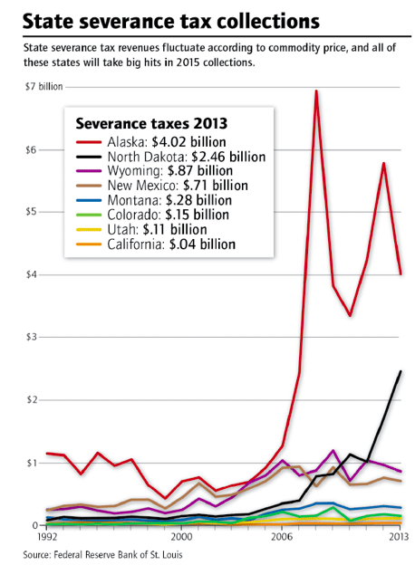
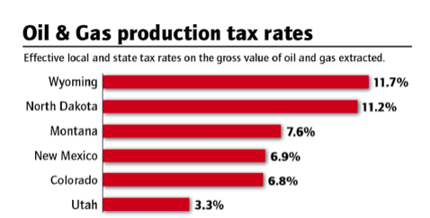
Lessons from Boom & Bust in NM
Energy Return off Investment (EROI) less than 1 means more energy expended getting the energy resource than it can deliver payback.
As a Leader do you:
Treat environmentalists as bigger threat than price volatility of oil & gas
Find alternatives to oil & gas economy energy
Hunker down, tighten your belt, & endure it.
Raise Severance Tax Rate that funds NM Education

Slide 14
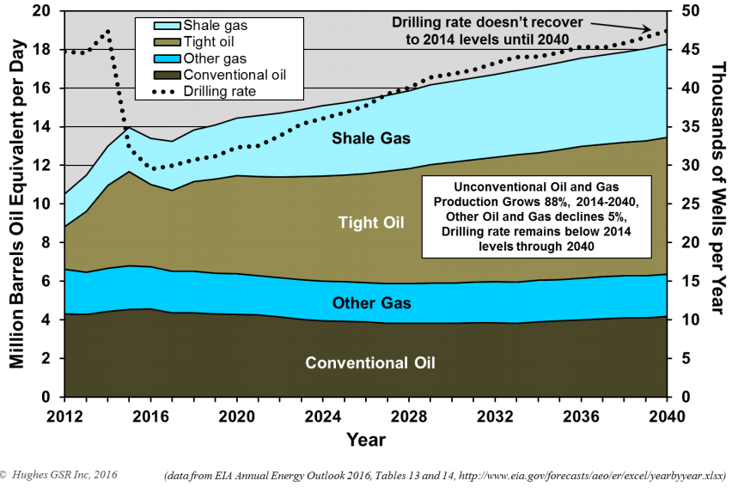

Slide 15
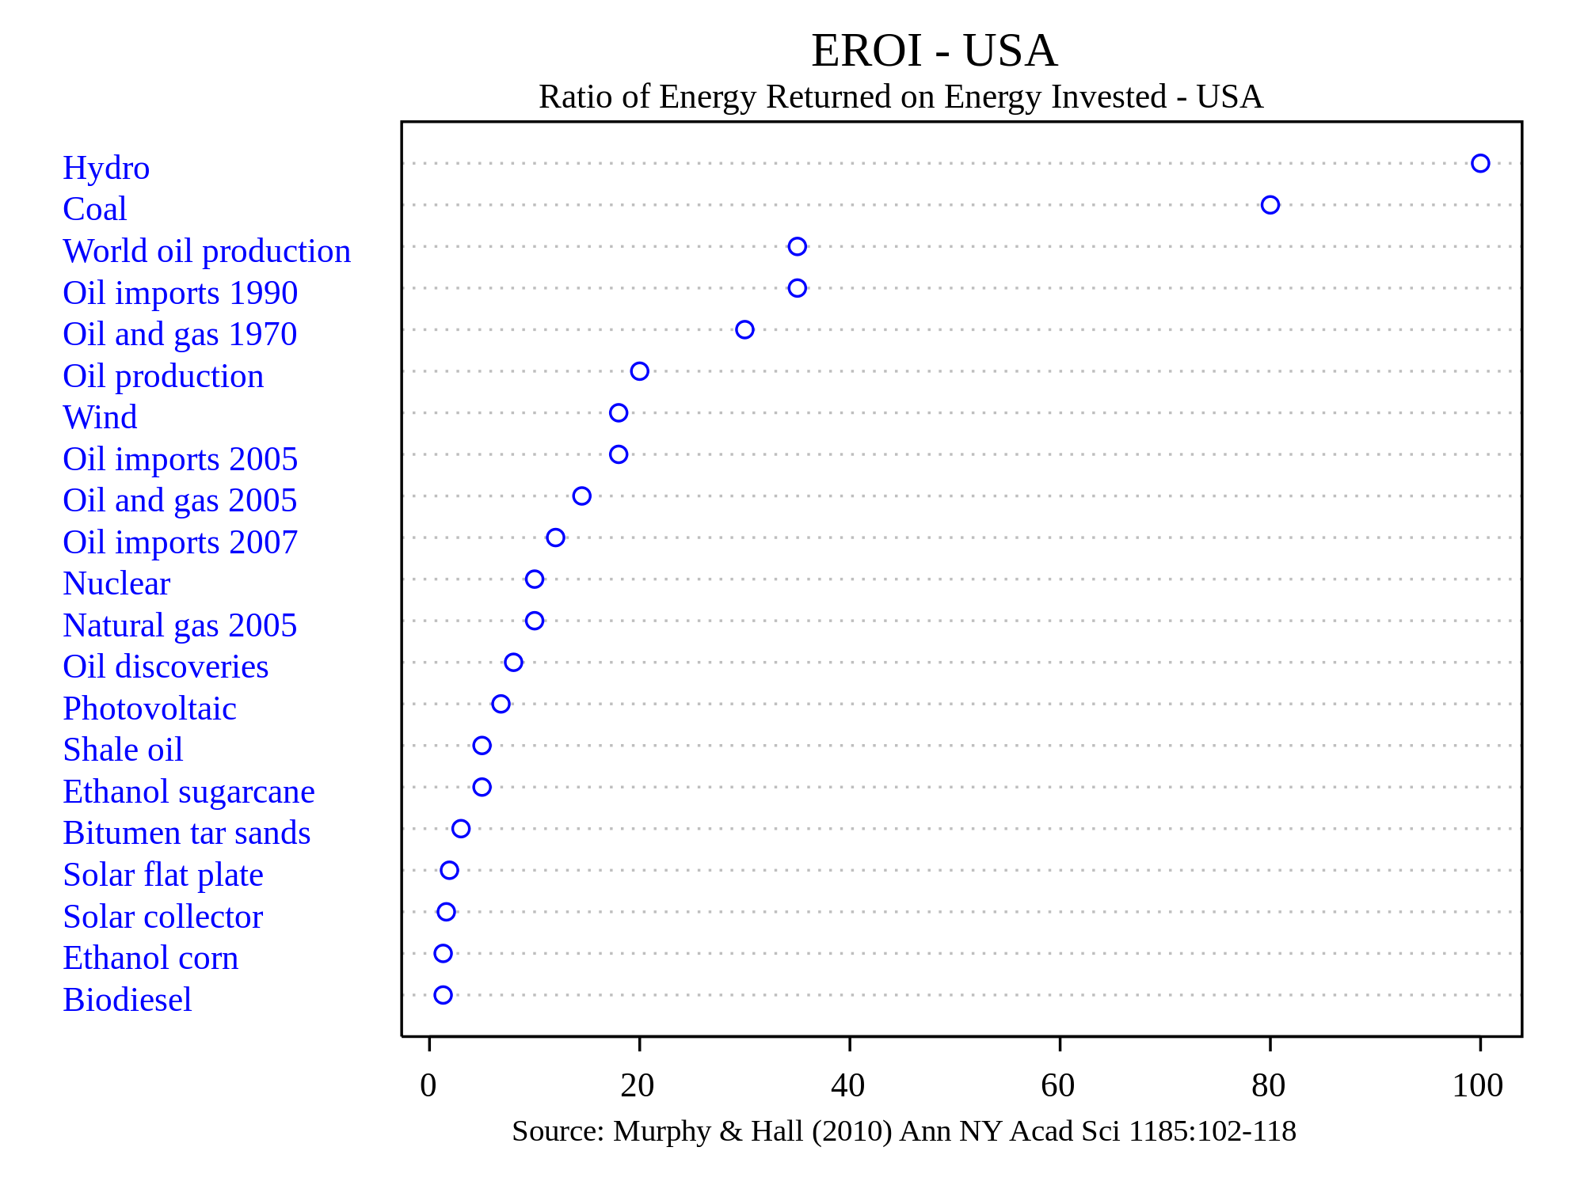

Slide 16
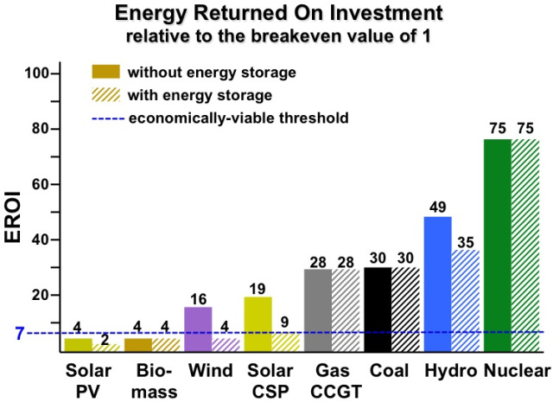
CCGT➔Combined Cycle Gas Turbine

Slide 18
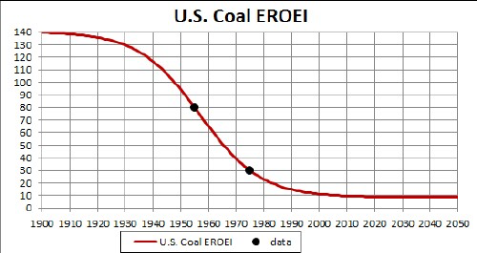
After 1990, it was more cost-effective to leave coal in the ground

Slide 19
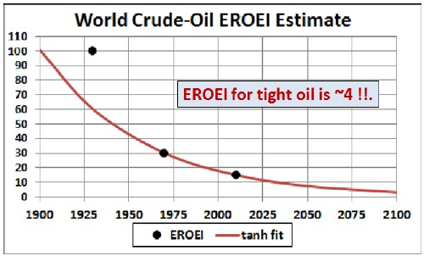
At some point oil has low EROI

Slide 21
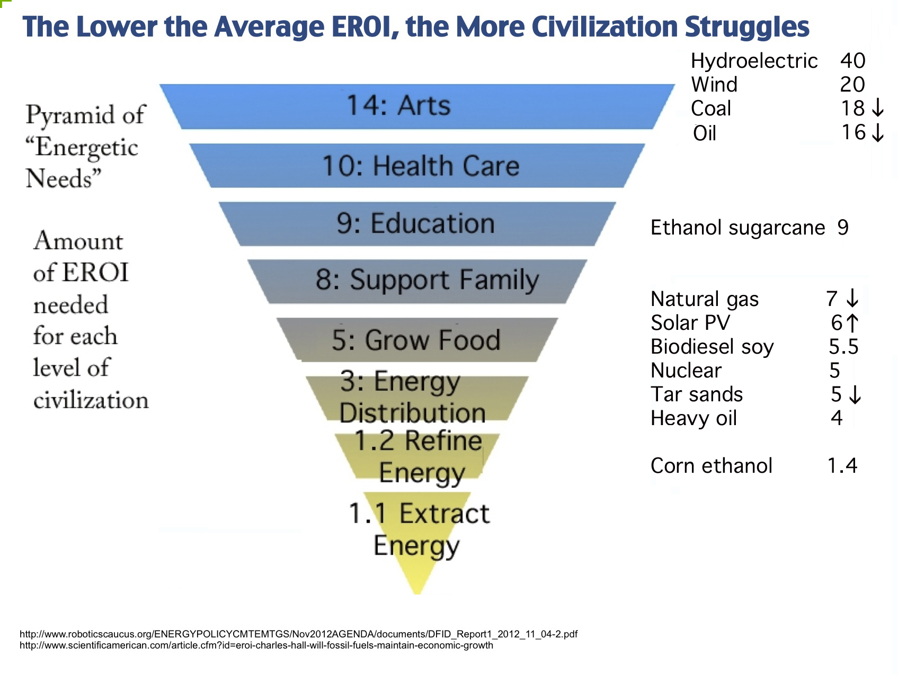

Slide 22
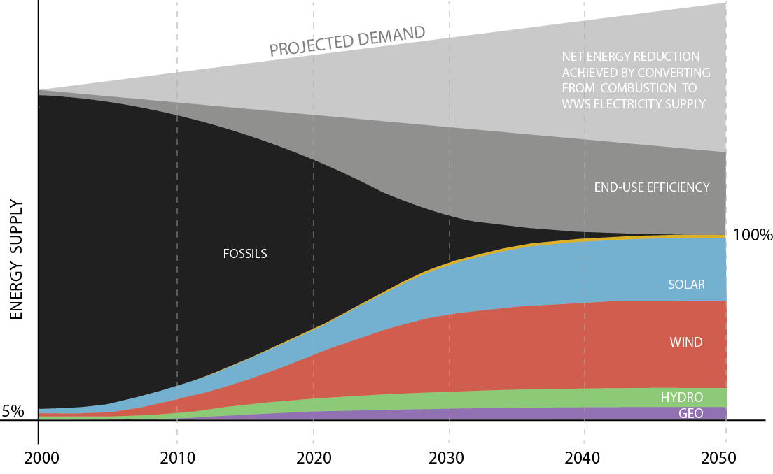
https://dotearth.blogs.nytimes.com/2013/03/12/can-wind-water-and-sunlight-power-new-york-by-2050/

Slide 23
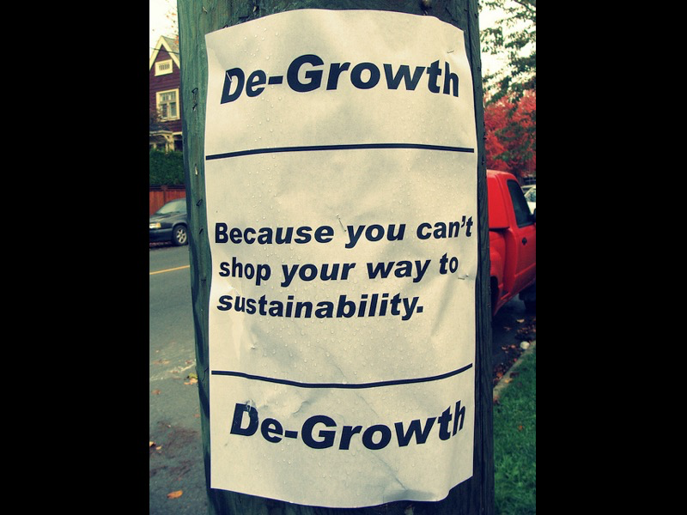
We are already
de-growing
Growth Scenarios are Unrealistic because EROI is decreasing each year
It costs more to get the energy than the energy it generates
Schumacher (1973) SMALL IS BEAUTIFUL
SIMPLIFY
MINIMALIZE
RETHINKING GROWTH YOUTUBE
https://www.youtube.com/watch?time_continue=264&v=0MXP2E09dJQ
More at http://rethinkingprosperity.org/solutions-degrowth/

Slide 24
Smaller Business has Smaller Footprint
Descale Big Business to Smaller Business
Descaling Business leads to greater Health, Happiness, and Terrific Well-Being
Less production & less consumption, is less Climate Change & less energy extraction
More local produce; more local production, and less transportation of goods
Descale production, distribution, & consumption to the limits of the ecosystem

Slide 25
Why Work 40 to 60 hours a week?
Work less, buy less, consume less, & Share More
Descale the home to 1970s size, or Tiny Home
Join Time Bank and trade your hours for others’ services
Grow a vegetable and fruit community garden to become more autonomous.
De-addiction from the decadence of consumerism; Try Sustainable Consumption; Try Simplicity
Life in a DeGrowth Economy & why you might actually enjoy it?

Slide 26
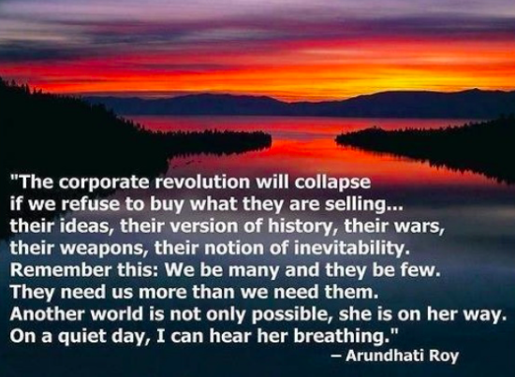
Leadership & Small Business in DeGrowth
Notes:
https://www.slideshare.net/rogeryates1/happy-degrowth-1

